Slide 1



Growth of Arctic Sea Ice Algae in an Analogue of Icy Worlds
Student: Jonathan Durkin
Mentor: Susanne Neuer

Slide 2
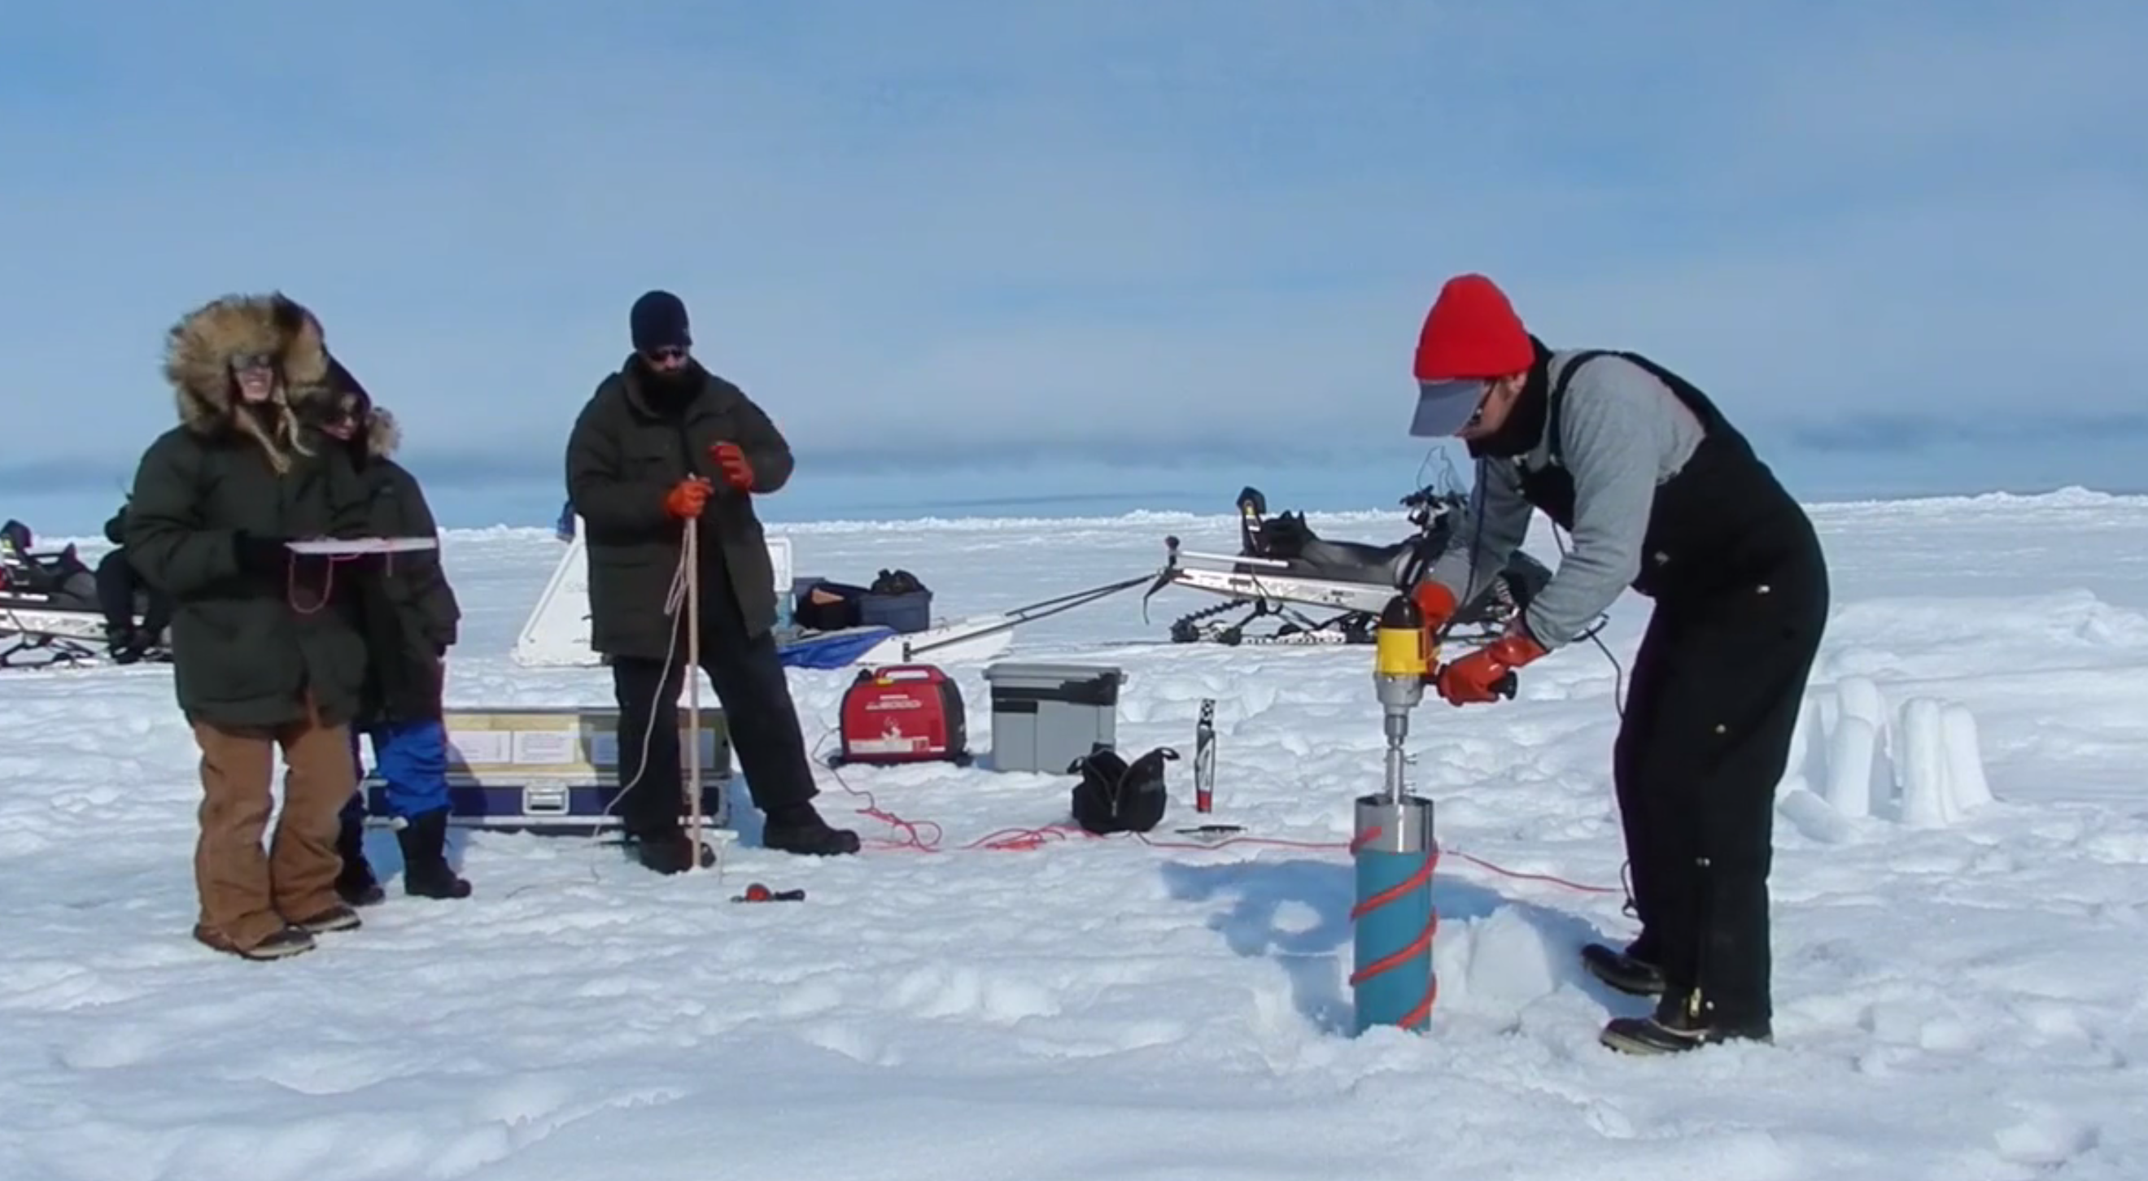
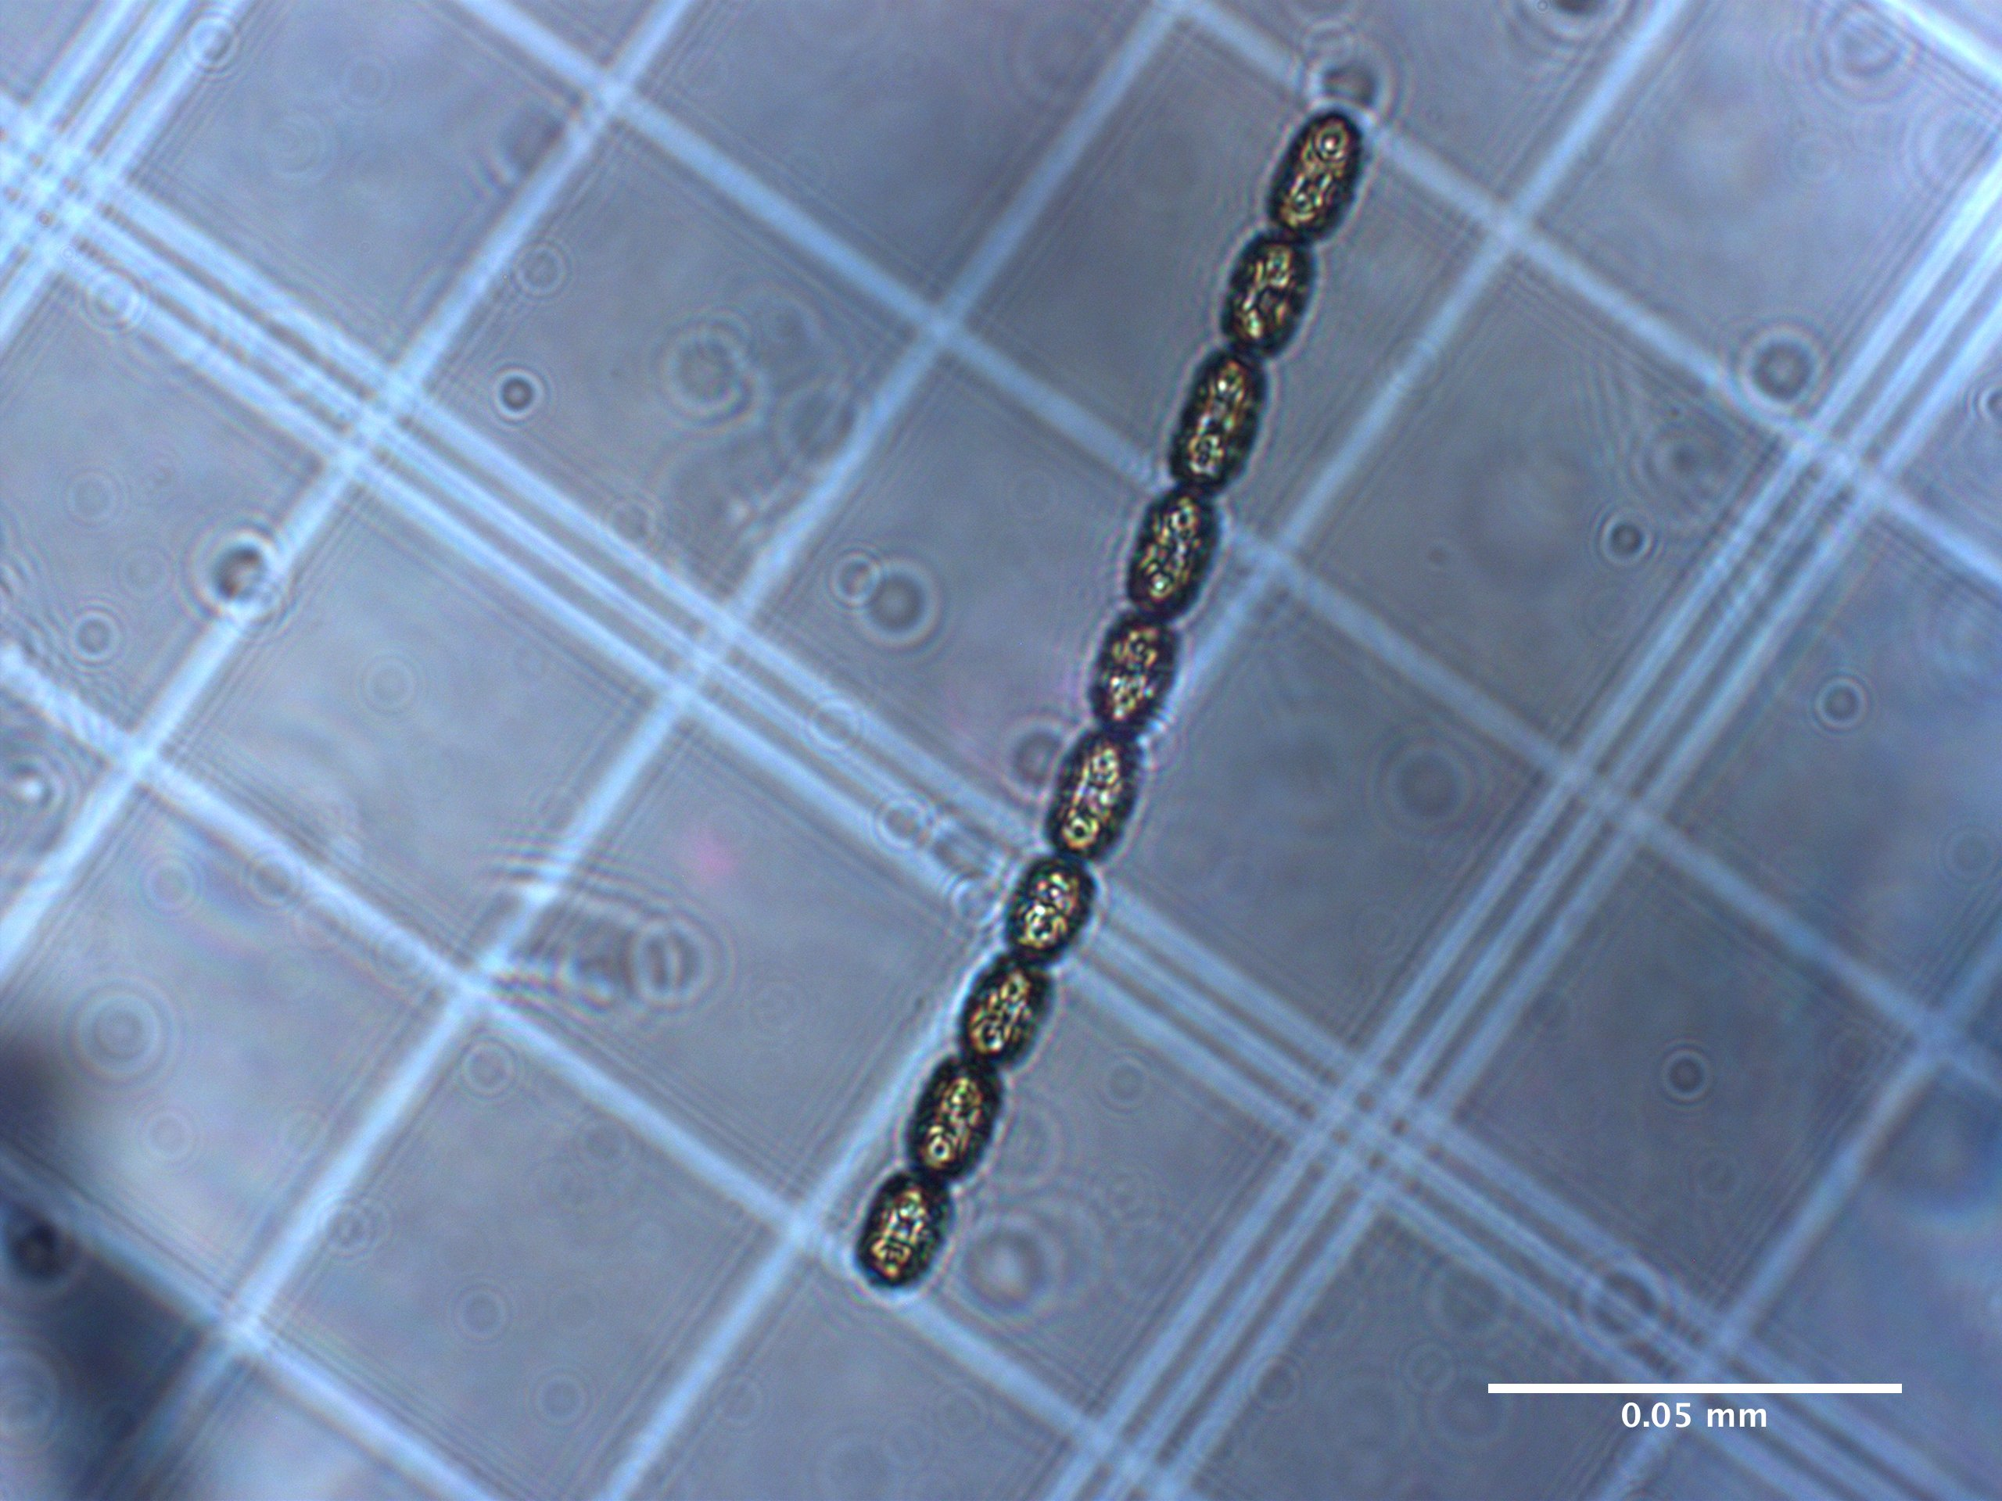
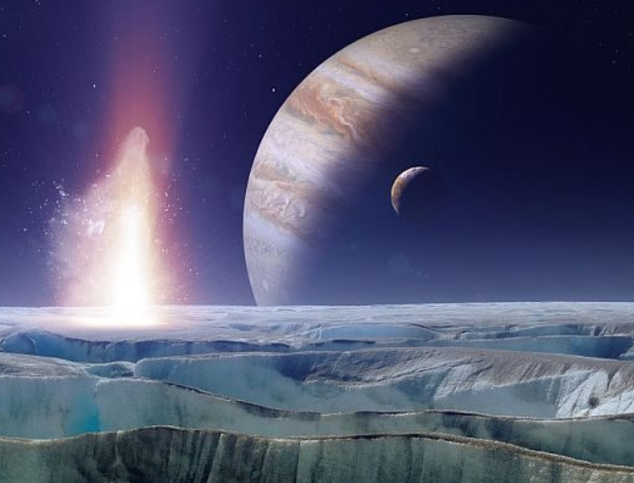
Growth of Arctic Sea Ice Algae in an Analogue of Icy Worlds
Introduction
Arctic Sea Ice Algae: Melosira arctica
Centric Diatom, creates energy via photosynthesis and is cornerstone of Arctic Food Web.
By adjusting light, salinity and temperature, I am testing the limits of growth for Melosira arctica.
Student: Jonathan Durkin
Mentor: Susanne Neuer
Introduction
Environment
Methodology
Results
Icy Worlds Analogue
Future Research
Samples retrieved from ice near Barrow, Alaska.
Gives insight into adaptability of life on Earth and credence of possibility of life on other icy worlds in solar system.

Slide 3
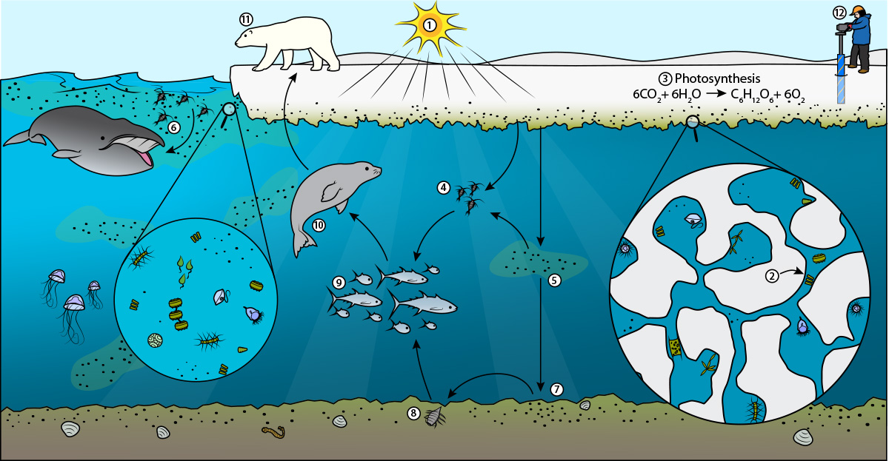
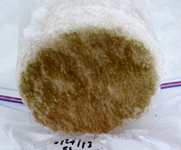
Growth of Arctic Sea Ice Algae in an Analogue of Icy Worlds
Land Fast Sea Ice Environment
Brine Melt Channels:
Melt in Spring -> More Fresh Water -> Less Salty Waters
Freeze over in Fall -> Brine Exclusion -> Saltier Waters
Student: Jonathan Durkin
Mentor: Susanne Neuer
Introduction
Environment
Methodology
Results
Icy Worlds Analogue
Future Research

Slide 4
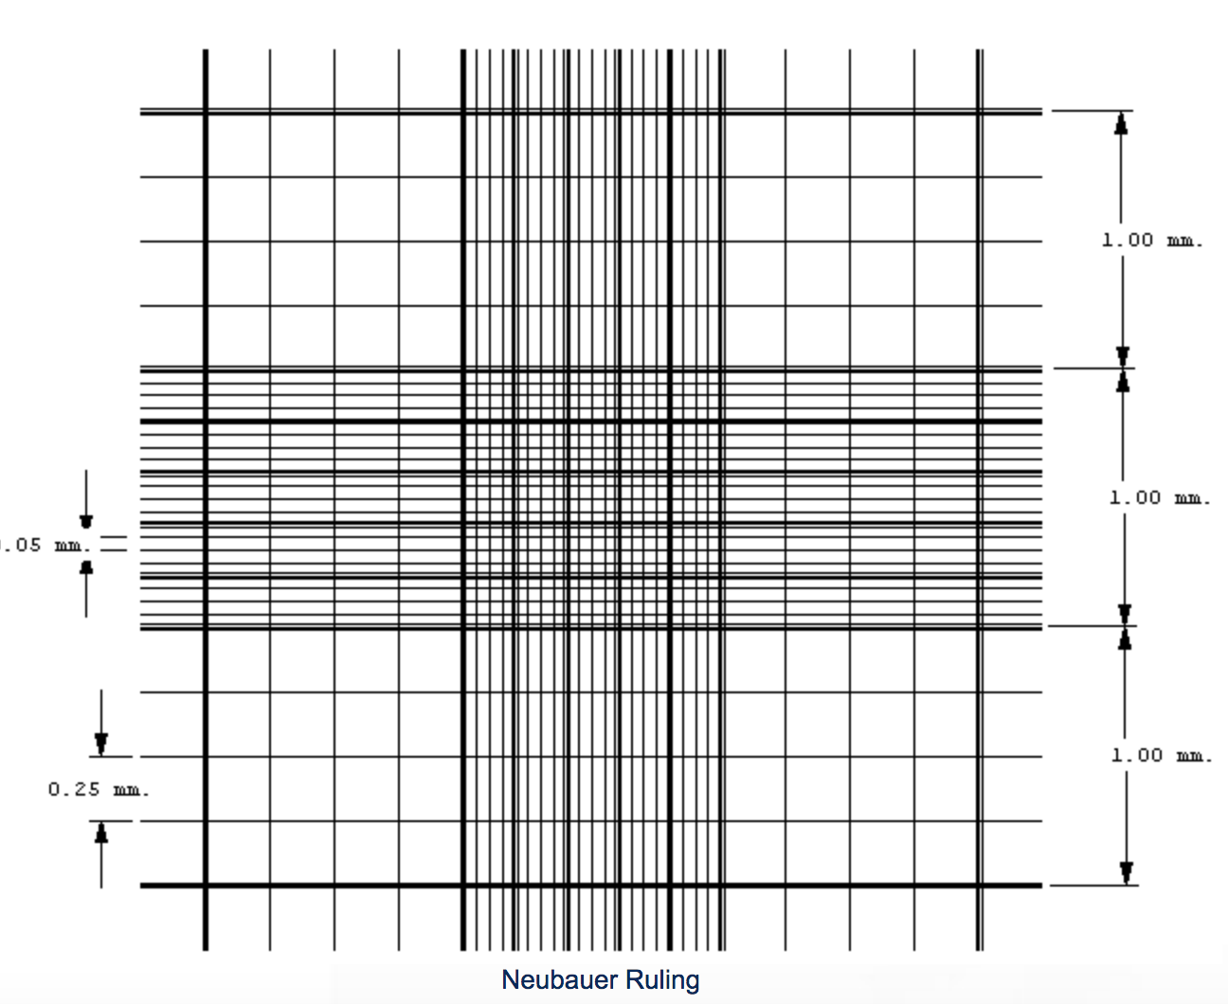
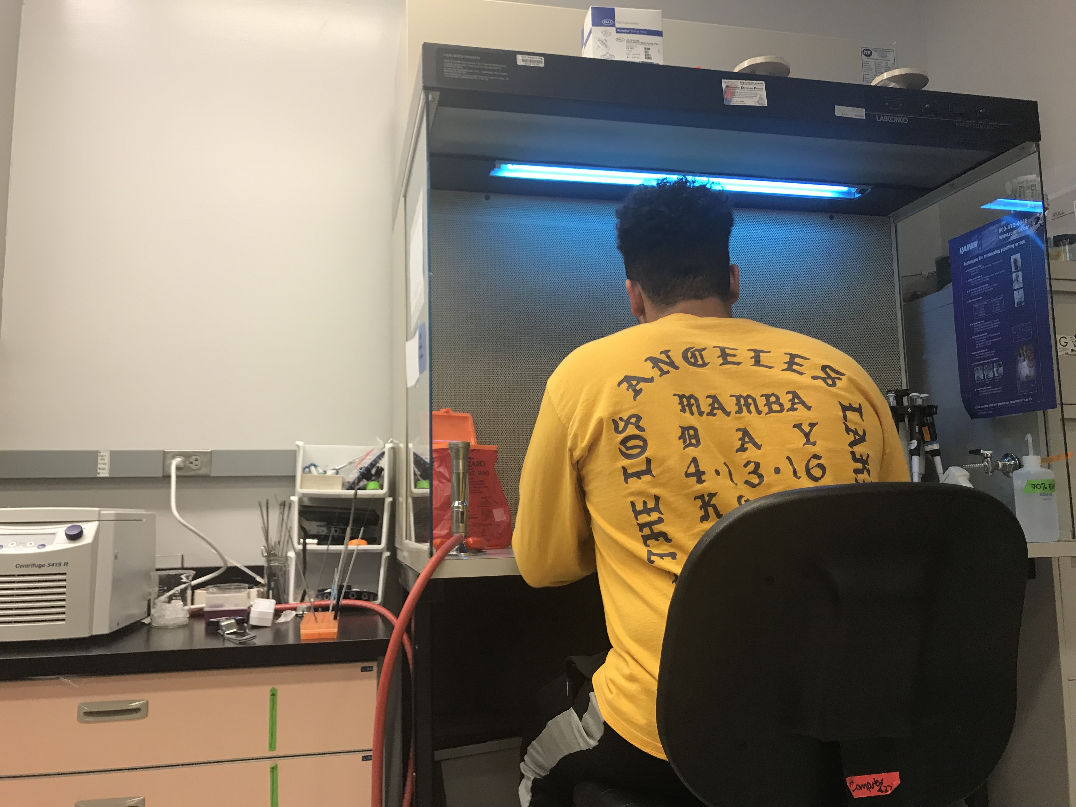
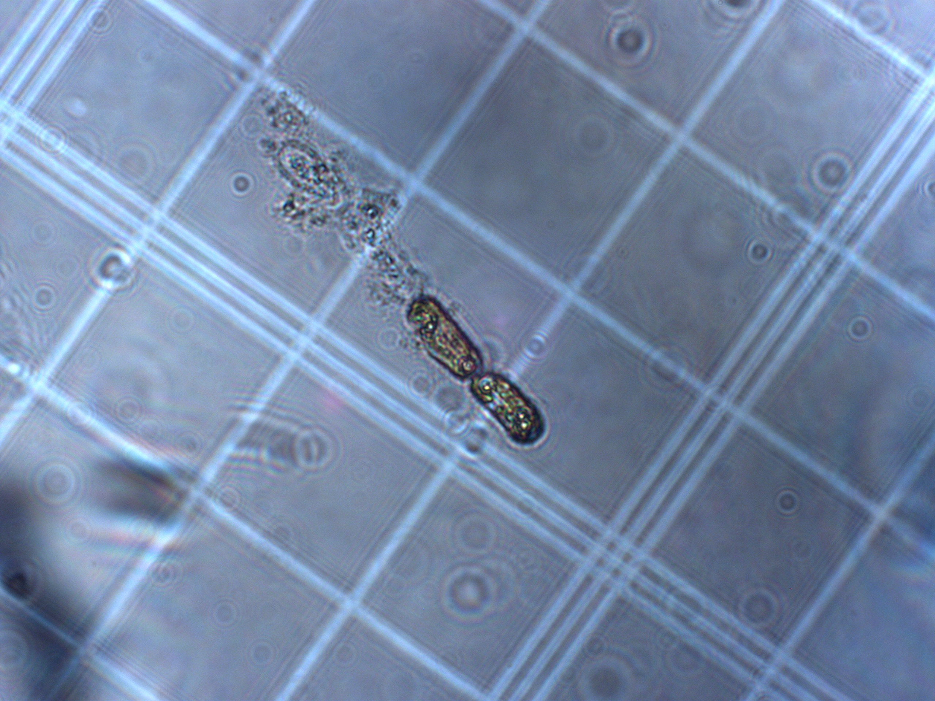
Growth of Arctic Sea Ice Algae in an Analogue of Icy Worlds
Experimental Setup and Methods
Student: Jonathan Durkin
Mentor: Susanne Neuer
Media made in sterile conditions using artificial seawater of varying salinities.
Flasks placed in incubators of varying temperatures.
Cells Counted under Zeiss microscope using Hemocytometer.
Cell counts used to generate growth rates in Excel by using exponential growth rate formula.
Introduction
Environment
Methodology
Results
Icy Worlds Analogue
Future Research
Notes:
μ = ln(N_{f} / N_{o}) / t
where:
t = time of exponential growth
N_{f} = Abundance at End of exponential Growth
N_{o} = Abundance at beginning of exponential Growth

Slide 5
Growth of Arctic Sea Ice Algae in an Analogue of Icy Worlds
Results
Growth Rate (d⁻¹), By Temperature and Salinity
Salinity | 0 Degrees | 4 Degrees | 10 Degrees | 15 Degrees
S5 | N/A | 0 | 0 | N/A
S15 | X | 0.28 | 0.36 | X
S30 | X | 0.36 | 0.53 | X
S60 | To Do | 0.24 | 0.39 | X
S75 | To Do | 0.30 | 0.29 | X
Student: Jonathan Durkin
Mentor: Susanne Neuer
Introduction
Environment
Methodology
Results
Icy Worlds Analogue
Future Research
X – Survives but does not grow.
For Comparison
Average Arctic Sea Water Temp: -1.8 ℃
Average Sea Water Salinity: 35 ppt
Cloudy Winter Day in Flagstaff:
~ 50 µmol/m2/s
Bright Sunny Day in Tempe:
~ 2000 µmol/m2/s

Slide 6
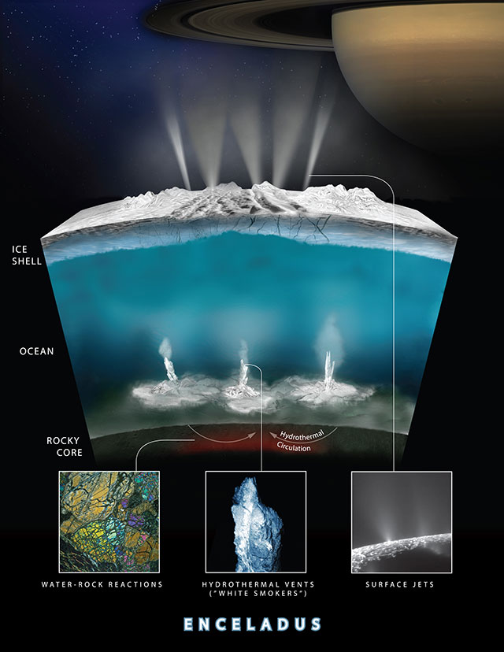
Growth of Arctic Sea Ice Algae in an Analogue of Icy Worlds
Icy World Analogue
October 28, 2015: Cassini Fly-By mission revealed potential hydrothermal activity and ingredients for life on Encaledus.
Ingredients for Life: Liquid Water + CHNOPS there
Encaledus vs. Arctic:
Less Light, higher reliance on hydrothermal energy
Methanogenesis vs Photosynthesis
Encaledus 73.75 times dimmer than Earth
27 µmol/m2/s In Growth Range of Melosira arctica
Question Remains Open: Given the adaptability of life on Earth to similar conditions, could there be life on an icy world such as Enceladus or Europa?
Student: Jonathan Durkin
Mentor: Susanne Neuer
Introduction
Environment
Methodology
Results
Icy Worlds Analogue
Future Research
Notes:
However, Given that I = S/4pi(r²)
Enceladus 790 Million Miles
Earth 92 Million Miles
-> 2000/73.75 =

Slide 7
Growth of Arctic Sea Ice Algae in an Analogue of Icy Worlds
Potential Future Research
Student: Jonathan Durkin
Mentor: Susanne Neuer
- Morphological Study
- Nutrient Limitation Study
- Europa Clipper
Introduction
Environment
Methodology
Results
Icy Worlds Analogue
Future Research

Slide 8

Growth of Arctic Sea Ice Algae in an Analogue of Icy Worlds
Acknowledgements
Student: Jonathan Durkin
Mentor: Susanne Neuer
Special Thanks to Dr. Neuer, Bianca Cruz, Jasmine Smalls and the rest of the Neuer Lab,
Desiree Crawl, Dr. Sharp, Mom and Grandpa
and all the great teachers I’ve had along the way!

Slide 9
Growth of Arctic Sea Ice Algae in an Analogue of Icy Worlds
Student: Jonathan Durkin
Mentor: Susanne Neuer
Questions?

